Slide 1

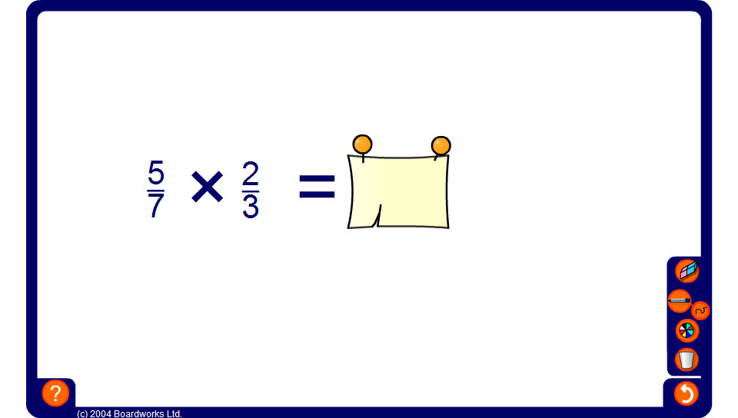


Multiplying fractions mentally
Notes:
Practice multiplying fractions mentally. Ask pupils for the solution to the calculation, and then check it by revealing the answer.

